Slide 1
Project: Iris Flower Student Name: Amin Kamranfar
Link to Github:
Related-papers-and-documents
Project

Slide 2
Contents
Problem Statement and background
Methods
Tools and Rationale
Results
Lessons Learned

Slide 3
Placeholders
“Update 03/March/2021: Updated to reflect changes to the scikit-learn API in version 0.18.
Update 05/March/2021: Added links to help setup your Python environment.
Update 06/March/2021: Added some helpful links about randomness and predicting.
Update 09/March/2021: Added link to my own hosted version of the dataset.
Update 15/March/2021: Updated for sklearn v0.20, also updated plots.
Update 19/March/2021: Added links at the end to additional tutorials to continue on.
Update 26/March/2021: Added full code examples for each section.
Update 01/April/2021: Updated examples to remove warnings due to API changes in v0.22.
Update 04/April/2021: Updated to remove the snippet for the test harness.”

Slide 4
Motivation
Learning Machine Learning
Learning different algorithms
Learning different data preprocessing techniques
linear discriminant analysis
learning using Python and the tool Scikit-Learn
Statistical classification for support vector machines

Slide 5
Description of the Problem
Use of Multiple Measurement in Taxonomic problems
The dataset is often used in data mining, classification and clustering examples and to test algorithms
Differentiate Iris species based on the morphology of their flowers

Slide 6
Platform
Installing the Python and SciPy platform.
Loading the dataset.
Summarizing the dataset.
Visualizing the dataset.
Evaluating some algorithms.
Making some predictions.

Slide 7
Methods (Installing the Python and SciPy platform)
# Python version
import sys
print('Python: {}'.format(sys.version))
# scipy
import scipy
print('scipy: {}'.format(scipy.__version__))
# numpy
import numpy
print('numpy: {}'.format(numpy.__version__))
# matplotlib
import matplotlib
print('matplotlib: {}'.format(matplotlib.__version__))
# pandas
import pandas
print('pandas: {}'.format(pandas.__version__))
# scikit-learn
import sklearn
print('sklearn: {}'.format(sklearn.__version__))

Slide 8
Load the Dataset
Import libraries
Importing all required modules such as:
from sklearn.model_selection import train_test_split
from sklearn.model_selection import cross_val_score
from sklearn.model_selection import StratifiedKFold
Load Dataset
url = "https://raw.githubusercontent.com/jbrownlee/Datasets/master/iris.csv"
names = ['sepal-length', 'sepal-width', 'petal-length', 'petal-width', 'class']
dataset = read_csv(url, names=names)

Slide 9
Exploring and Processing Dataset
sepal-length sepal-width petal-length petal-width class
0 5.1 3.5 1.4 0.2 Iris-setosa
1 4.9 3.0 1.4 0.2 Iris-setosa
2 4.7 3.2 1.3 0.2 Iris-setosa
3 4.6 3.1 1.5 0.2 Iris-setosa
4 5.0 3.6 1.4 0.2 Iris-setosa
5 5.4 3.9 1.7 0.4 Iris-setosa
6 4.6 3.4 1.4 0.3 Iris-setosa
7 5.0 3.4 1.5 0.2 Iris-setosa
8 4.4 2.9 1.4 0.2 Iris-setosa
9 4.9 3.1 1.5 0.1 Iris-setosa
10 5.4 3.7 1.5 0.2 Iris-setosa
sepal-length sepal-width petal-length petal-width class
11 4.8 3.4 1.6 0.2 Iris-setosa
12 4.8 3.0 1.4 0.1 Iris-setosa
13 4.3 3.0 1.1 0.1 Iris-setosa
14 5.8 4.0 1.2 0.2 Iris-setosa
15 5.7 4.4 1.5 0.4 Iris-setosa
16 5.4 3.9 1.3 0.4 Iris-setosa
17 5.1 3.5 1.4 0.3 Iris-setosa
18 5.7 3.8 1.7 0.3 Iris-setosa
19 5.1 3.8 1.5 0.3 Iris-setosa

Slide 10
Summarize the Dataset
Dimensions of Dataset
Peek at the Data
Statistical Summary
Class Distribution
Complete Example

Slide 11
Building Model
We can get the correct species of iris using supervised learning. The outcome is supposed to let us know about the classification. This model is a three-class classification problem which the outcome is the species of the flower considering it’s features.
iris_dataset = load_iris()
print("Target names: {}".format(iris_dataset['target_names']))
print("Feature names: {}".format(iris_dataset['feature_names']))
print("Type of data: {}".format(type(iris_dataset['data'])))
Output:
Target names: [‘setosa’ Versicolor’ Virginica’]
Feature names: [‘ Sepal Length (cm), Sepal width (cm), Petal length (cm), petal width (cm) ]
Types of data: <Class ‘numpy.ndarray’>

Slide 12

The scatter plot

Slide 13
Tools and the Rationale
Taking advantages of machine learning using Python
Handling data to figure out numeric attributes of dataset
Learning data by classification problem
Practicing supervised learning algorithm
No need for any particular scaling or transforms

Slide 14
Preliminary results
We can understand a summary of each characteristic which is included in count, mean, the max and min values: Print(d ataset.describe())
sepal-length sepal-width petal-length petal-width
count 150.000000 150.000000 150.000000 150.000000
mean 5.843333 3.054000 3.758667 1.198667
std 0.828066 0.433594 1.764420 0.763161
min 4.300000 2.000000 1.000000 0.100000
25% 5.100000 2.800000 1.600000 0.300000
50% 5.800000 3.000000 4.350000 1.300000
75% 6.400000 3.300000 5.100000 1.800000
max 7.900000 4.400000 6.900000 2.500000

Slide 15
Update deliverable #3 Placeholders for the in-progress items
Update April/05/2021:Evaluate Some Algorithms
Update April/07/2021: Training strategy
Update April/10/2021: Variations of solutions
Update April/14/2021: Building Model
Update April/20/2021: Train and test on the same dataset
Update April/24/2021: Compare the performance
Update April/29/2021: Testing and conclusion
Update May/01/2021: Lesson learned and drafting final report
Update May/04/2021: Presentation preparation and recording

Slide 16
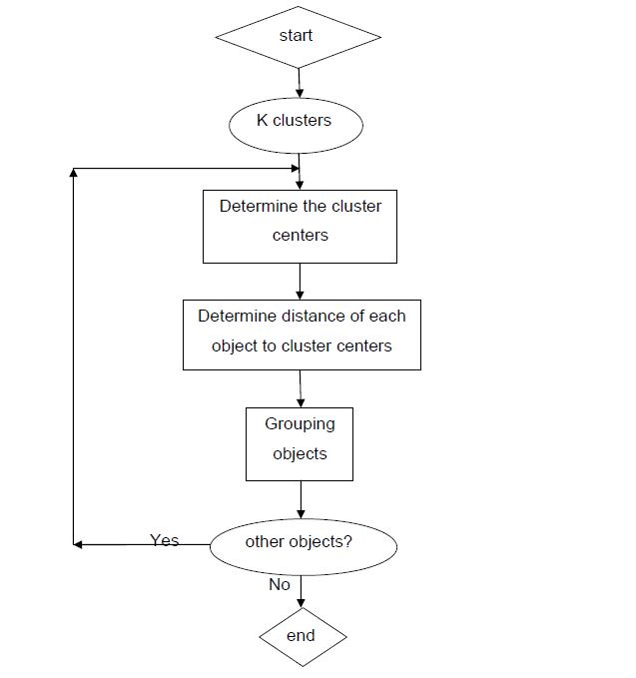
K-means clustering
Clustering aims to classify data from the whole data space
unsupervised learning is the K-means clustering algorithm
clustering algorithm groups all the same kind of data into one single class

Slide 17
Implementing K-means clustering on iris
Importing the required libraries:
#Import libraries
import numpy as np
import pandas as pd
import matplotlib.pyplot as plt
from sklearn.cluster import Kmeans
We can use head() to see data:
#import the dataset
df = pd.read_csv('iris.csv')
df.head(10)
Select iris dataset into variable X:
x = df.iloc[:, [0,1,2,3]].values

Slide 18
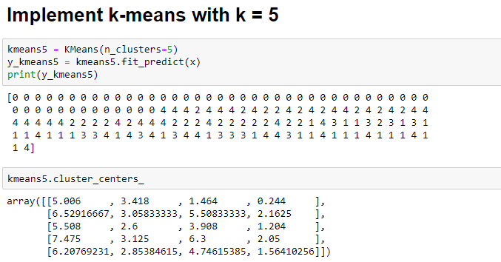
Implementing with k=5
We can instantiate the kmeans class:
kmeans5 = KMeans(n_clusters=5)
y_kmeans5 = kmeans5.fit_predict(x)
print(y_kmeans5)
kmeans5.cluster_centers_

Slide 19
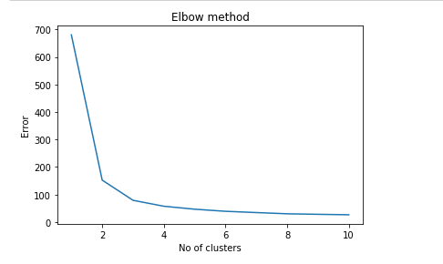
Graph of data
Elbow method to calculate the best value of K:
The optimal value of K is between 2 and 4:
Error =[]
for i in range(1, 11):
kmeans = KMeans(n_clusters = i).fit(x)
kmeans.fit(x)
Error.append(kmeans.inertia_)
import matplotlib.pyplot as plt
plt.plot(range(1, 11), Error)
plt.title('Elbow method')
plt.xlabel('No of clusters')
plt.ylabel('Error')
plt.show()

Slide 20
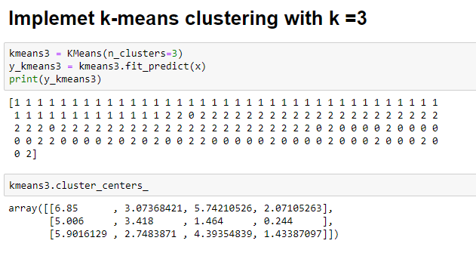
Implement k-means with K=3

Slide 21
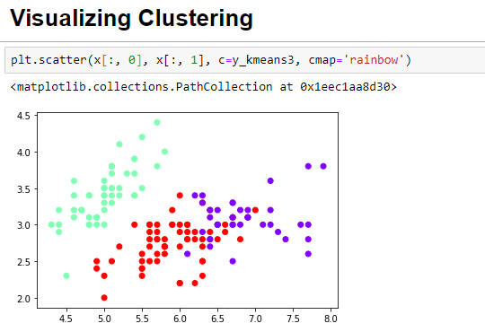
Cluster Visualization

Slide 22
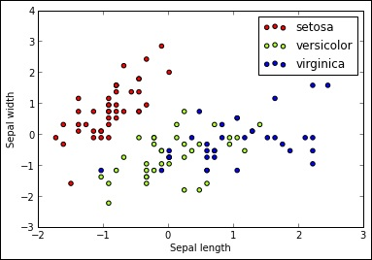
linear classification
>>> import matplotlib.pyplot as plt
>>> colors = ['red', 'greenyellow', 'blue']
>>> for i in xrange(len(colors)):
>>> xs = X_train[:, 0][y_train == i]
>>> ys = X_train[:, 1][y_train == i]
>>> plt.scatter(xs, ys, c=colors[i])
>>> plt.legend(iris.target_names)
>>> plt.xlabel('Sepal length')
>>> plt.ylabel('Sepal width')

Slide 23
Evaluating results

Slide 24
Clustering of Iris dataset with wrong instantiation

Slide 25
Decision Boundaries

Slide 26
Obtaining different results with different algorithms
ALGORITHM APPLIED | ACCURACY
K-NEAREST NEIGHBOR (N_NEIGHBORS =3) | 93%
K-NEAREST NEIGHBOR (N_NEIGHBORS =1) | 100.00%
LOGISTIC REGRESSION | 91.00%
LOGISTIC REGRESSION (TRAIN AND SPLIT METHOD) | 95.00%
K-NEAREST NEIGHBOR(TRAIN AND SPLIT METHOD AND N_NEIGHBORS=1) | 95.00%
K-NEAREST NEIGHBOR(TRAIN AND SPLIT METHOD AND N_NEIGHBORS=5) | 96.666667%

Slide 27
Final Observation
K-means algorithm, which is a very important machine learning algorithm from
the unsupervised learning method is used
Performances of the classifiers were measured and results are compared using the Iris Data set
Different methods such as SVM, KNN, and logistic regression have been analyzed to get good accuracy result
We can conclude that K-NEAREST NEIGHBOR approach is more effective than other methods

